Slide 1
Introduction to AI, fairness and bias
The pictures in these slides were generated using ChatGTP and Canva

Slide 2
AI - Introduction
Notes:
This section (or parts of it) can be used as an introduction or recap of basic concepts regarding AI and classification algorithms.

Slide 3
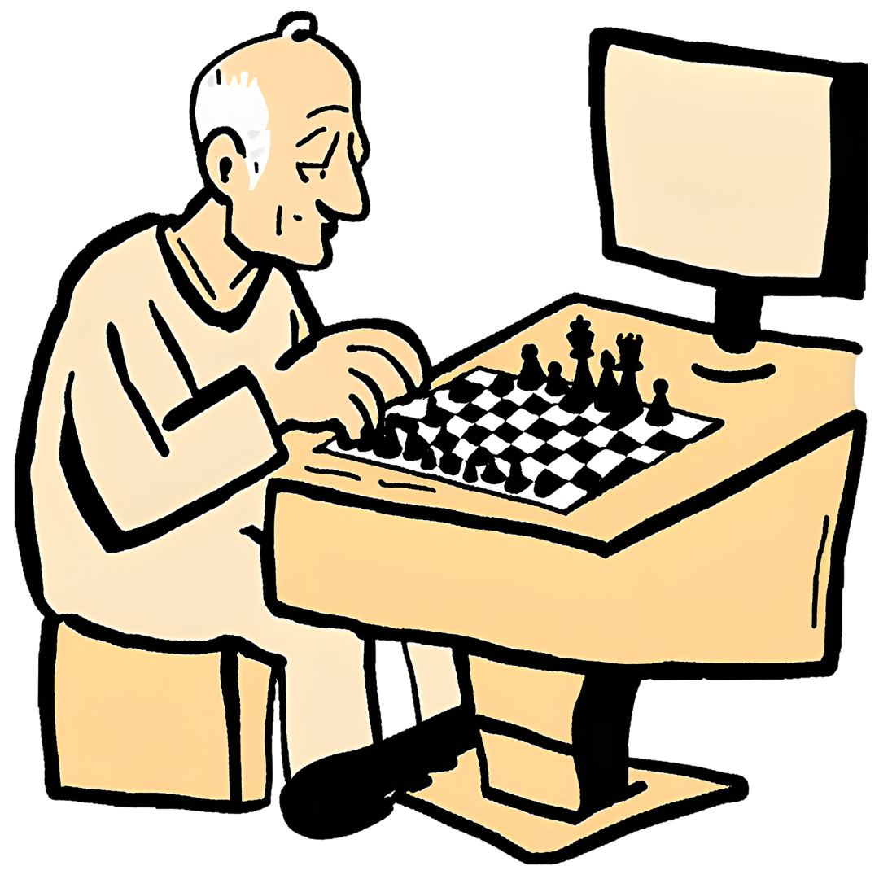
Artificial Intelligence around us
Artificial Intelligence refers to technological applications designed to simulate intelligence, such as the ability to learn, take decisions, and interact with surrounding environments
AI applications around us include:
Recommendation Systems (YouTube, Instagram…)
Virtual Assistants (Alexa, Siri…)
Generative algorithms (ChatGPT, Dall-E…)
Autonomous vehicles
Playing agents (Chess, Go, various videogames…)
Did you know that the best chess player in the world is a computer program called Stockfish? Its rating (a measure of chess proficiency) is more than 3600. The best ever human player’s rating is less than 2900.
Notes:
Use this slide to introduce AI common applications and benefits

Slide 4
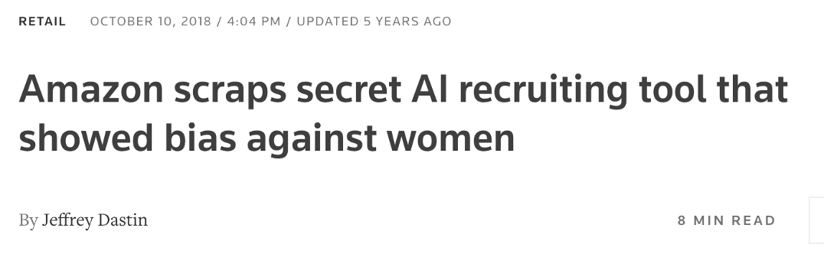
A real scenario
In 2014, a team at Amazon started working on an algorithm that would automatically rank candidates for hiring
Advantage: Amazon receives a lot of applications and it has an interest in identifying the best candidates quickly and effectively
But…
source: https://www.reuters.com/article/us-amazon-com-jobs-automation-insight-idUSKCN1MK08G/
Notes:
This slide is meant to generate doubt → AI applications can cause harm or not work as intended
Story: the algorithm was trained to analyze resumes; it was trained on the last 10 years of actual applications and hiring data; for tech positions, the algorithm learned that men were preferable, since most applicants and hires were men; it started ruling out women by looking for keywords in their resume, like “women’s chess team captain”; after some attempts to fix this, the project was abandoned in 2017.
Alternative source: https://globalnews.ca/news/4532172/amazon-jobs-ai-bias/

Slide 5
AI under scrutiny
Today, there is a call for increased attention toward responsible use of AI applications, including a focus on aspects such as:
Fairness = the idea that outcomes of an AI application must be equitable, i.e. no group should be discriminated against/receive a different treatment
Accountability = clearly identify people responsible for the outcomes and derived consequences
Transparency = the ability to explain outcomes and decisions, as well as transparency in data acquisition and provenance

Slide 6
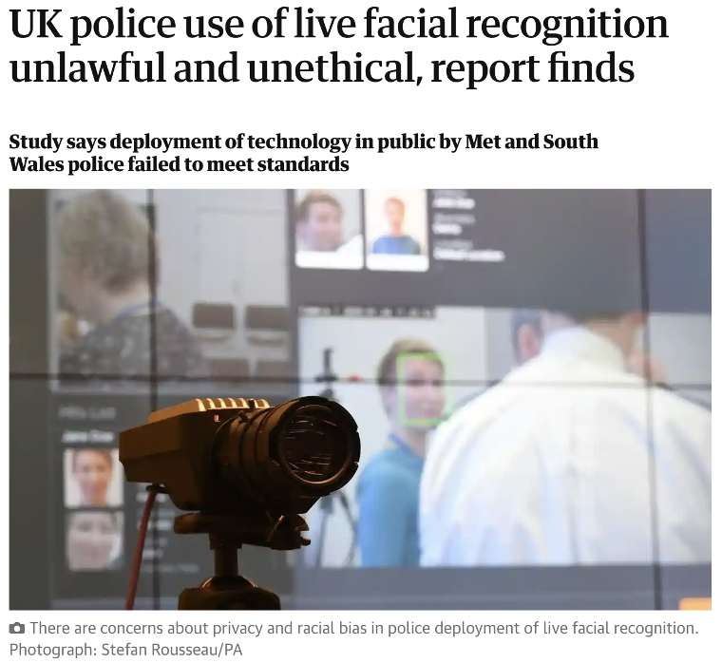
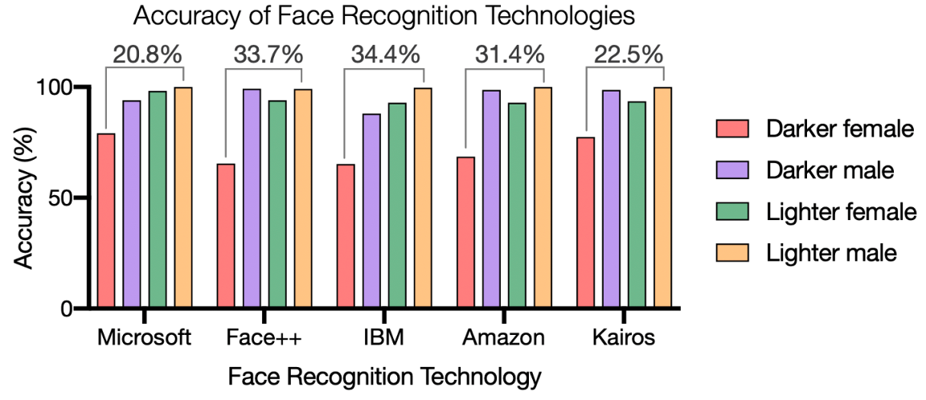
More examples: fairness
source: https://sitn.hms.harvard.edu/flash/2020/racial-discrimination-in-face-recognition-technology/
Source: https://www.theguardian.com/technology/2022/oct/27/live-facial-recognition-police-study-uk
Notes:
Story: human right activists in the UK are fighting against the use of Live Face Recognition (LFR), which the police hopes to use to fight crime and terrorism. The activists argue that this technology, on top of being an important invasion of privacy, was not reliable, with an accuracy of just 20%. Furthermore, for low level of confidence, the system was found to be biased against black people (i.e. when uncertain, it would flag a black person more frequently than a white or Asian one; source: https://www.theregister.com/2023/05/25/facial_recognition_system_used_by/).
Racial bias in face recognition algorithms is common, therefore applications must be chosen and monitored carefully.
Important note: face recognition algorithms are not unfair just for failing to recognize a black person, they are unfair because they do so at higher frequency than white people.

Slide 7
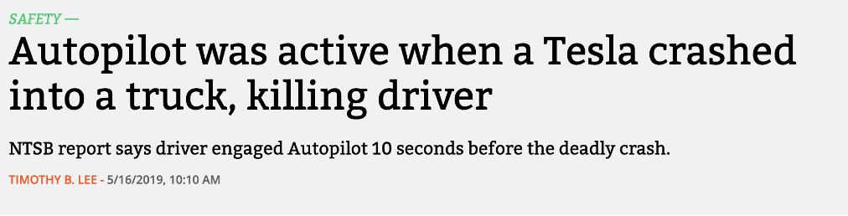
More examples: accountability
When technologies are involved, it is more difficult to pinpoint who is responsible when accidents happen.
This is a legislative gap. Unfortunately, technology move at a much faster pace than the law, so these episodes are not infrequent.
source: https://arstechnica.com/cars/2019/05/feds-autopilot-was-active-during-deadly-march-tesla-crash/
Notes:
Read and discuss story: https://arstechnica.com/cars/2019/05/feds-autopilot-was-active-during-deadly-march-tesla-crash/
Highlights: all parties involved had some level of responsibility. Tesla, because the algorithm failed to recognize the incoming truck; the driver, because he was using the autopilot in a non-recommended way and without paying attention; the truck driver, because they did a questionable maneuver to merge onto the highway.

Slide 8
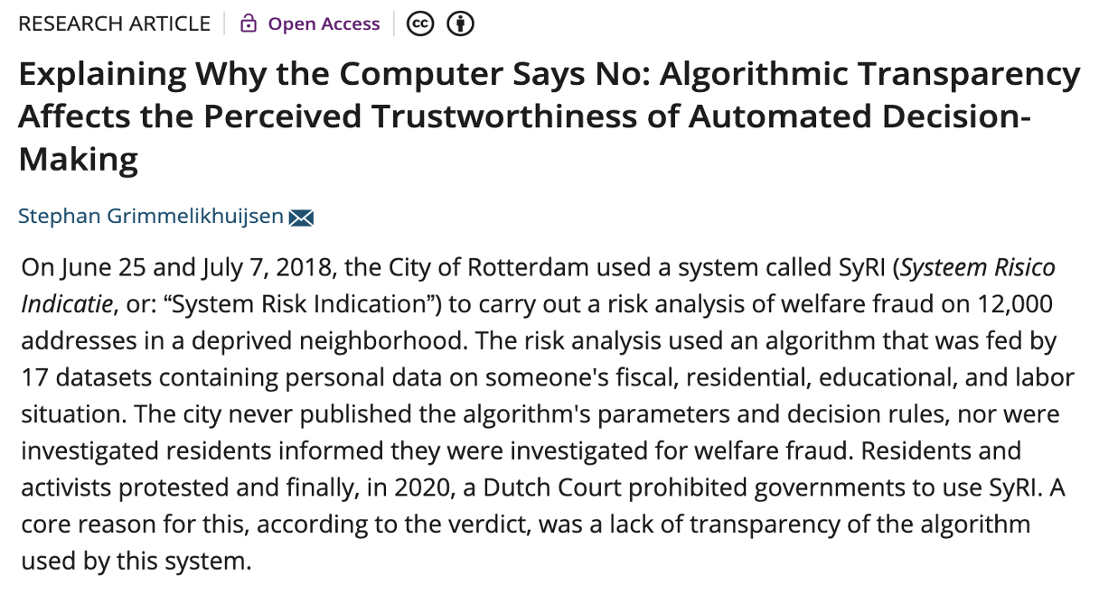
The issue of transparency
source: https://onlinelibrary.wiley.com/doi/full/10.1111/puar.13483
Notes:
Source (read): https://digitalfreedomfund.org/the-syri-victory-holding-government-profiling-to-account/
https://onlinelibrary.wiley.com/doi/full/10.1111/puar.13483
Issues (in order of highlight):
The algorithm and the way it operates are not public; people do not know why they have been classified a certain way
Often, they did not even know the algorithm was being used to classify them
It is also unclear if the data used to train the algorithm had this purpose disclosed to the owners

Slide 9
Data Bias
Notes:
In this section, we will talk in detail about fairness issues with AI applications, bias and its sources, and how to measure fairness. Students will need to understand basic performance metrics (accuracy, how to read a confusion matrix) and the idea of algorithm training (via examples)

Slide 10
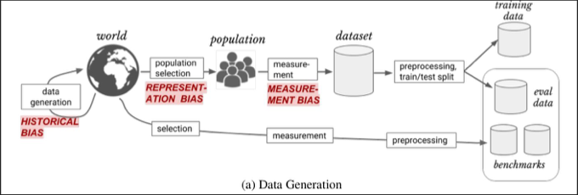
Bias in data
AI algorithms learn through the examples they are provided with, which together form what we call the training set.
Bias in the training set will affect the algorithm’s behavior, likely amplifying existing problems and mistakes.
Let’s explore a few ways in which a training set can be biased.

Slide 11
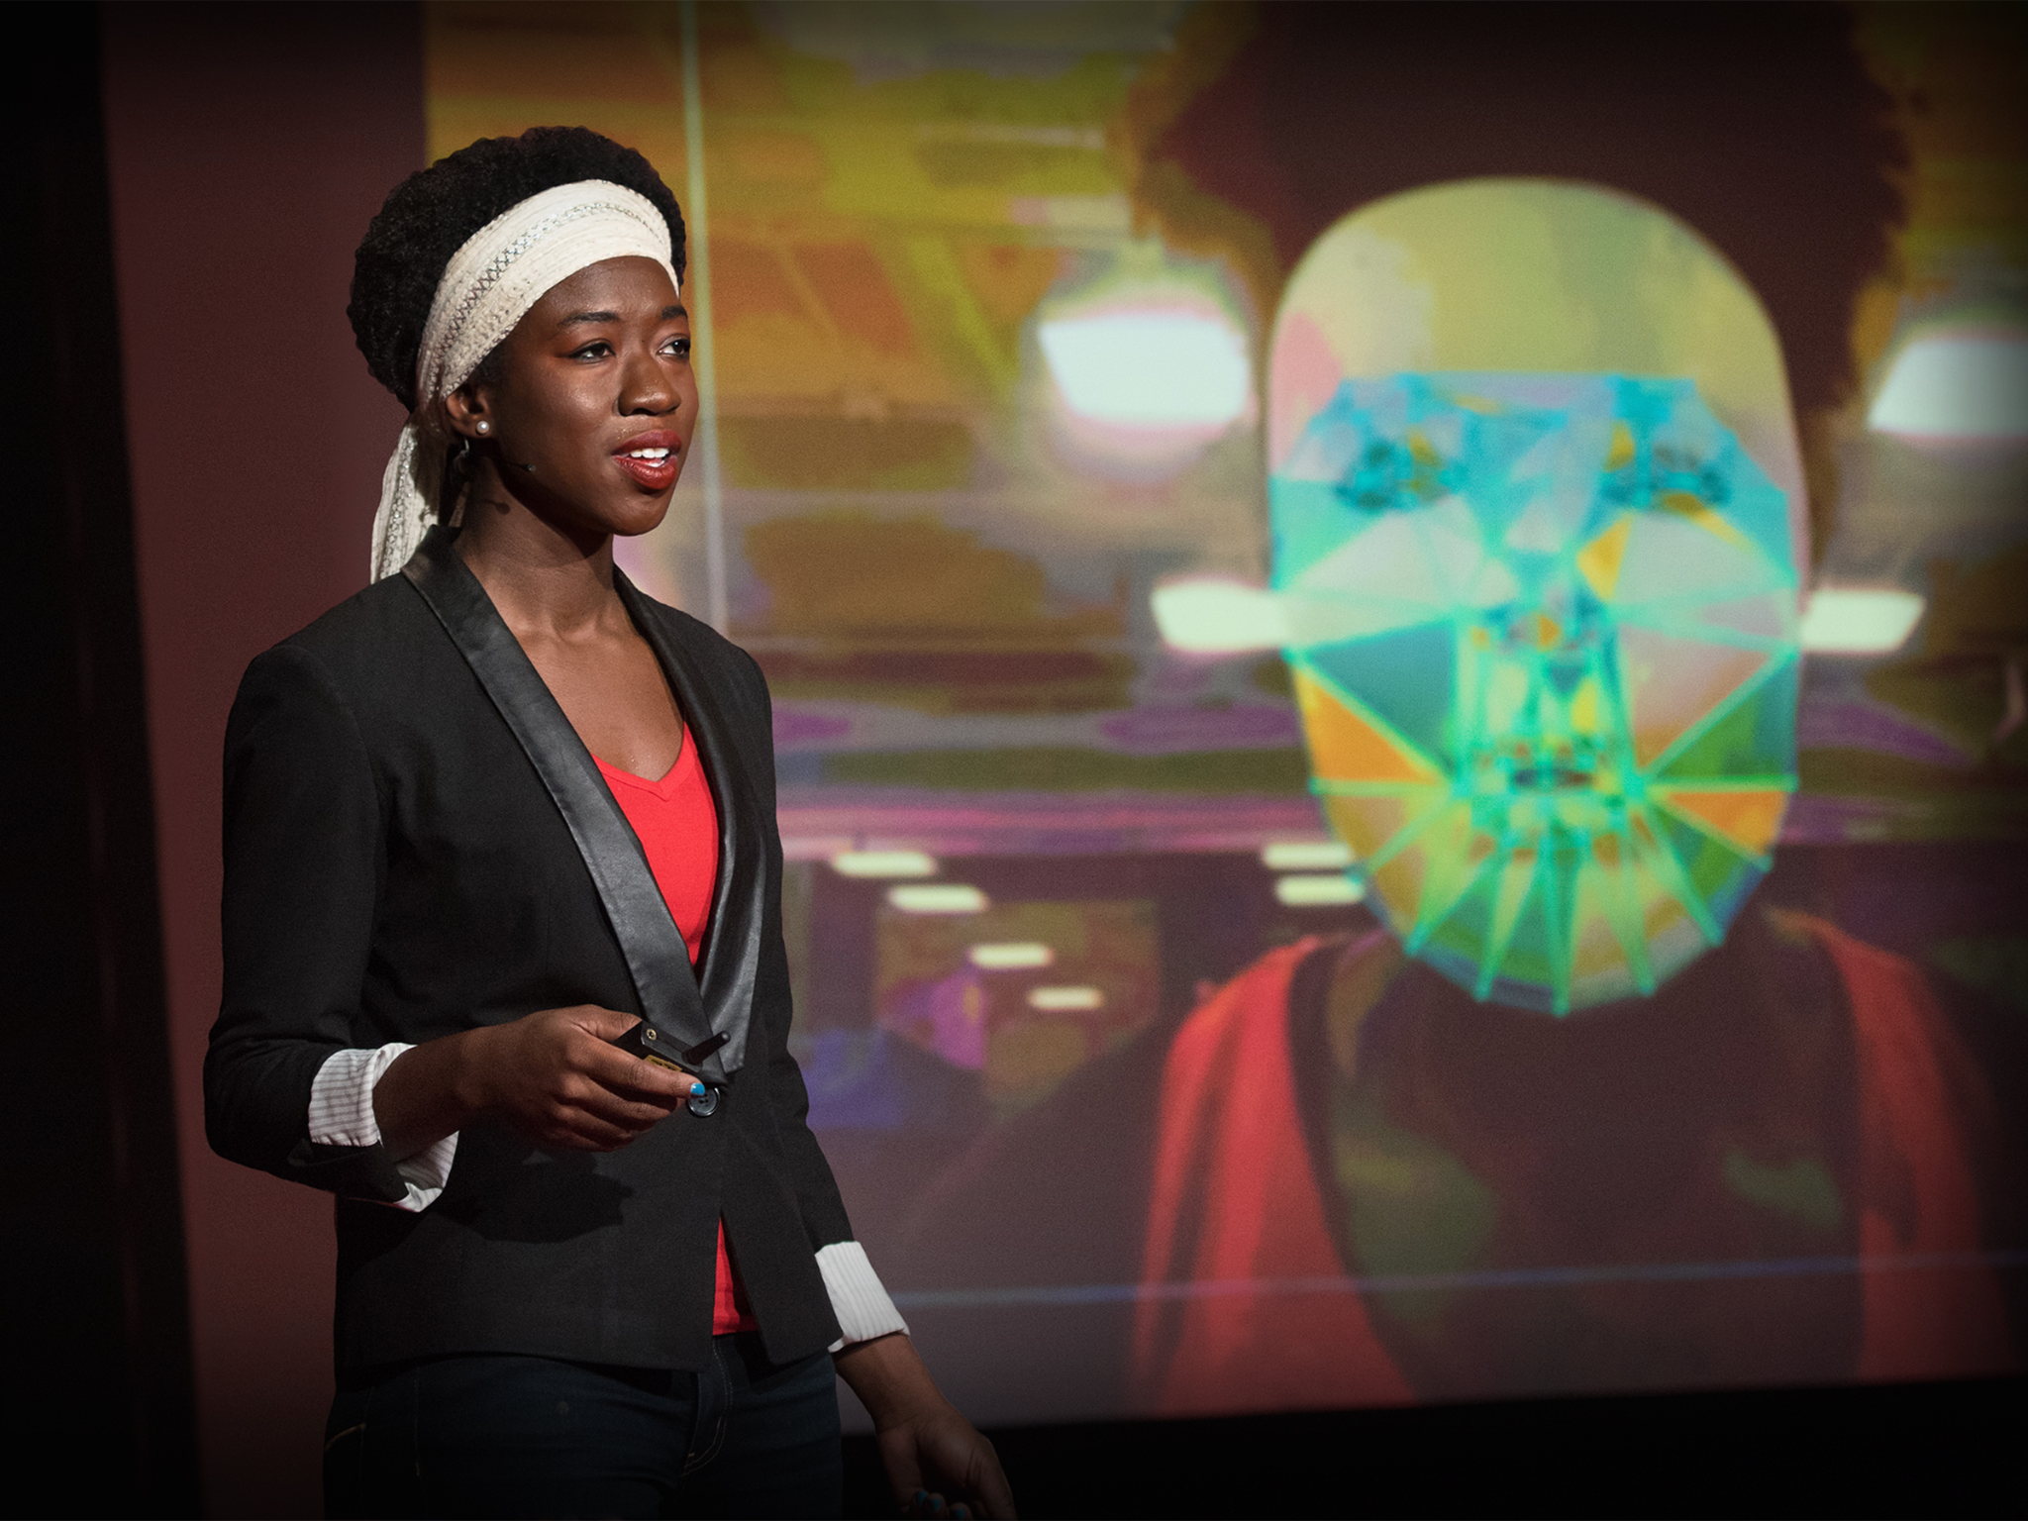
Representation bias
Representation bias happens when the training set is, essentially, incomplete, and a poor representation of the population we wish to apply the algorithm on.
Other times, representation bias happens when trying to use existing samples from a different time or place, instead of collecting new ones.
Dr. Joy Buolamwini demonstrating failures in face recognition.
Notes:
A famous example of representation bias was reported by Dr. Buolamwini, when she realized that most commercially available face recognition algorithms could not recognize her dark-skinned face. This happened because the algorithm was mostly trained on a sample of white, male individuals, and performed much worse when seeing other faces.

Slide 12
Measurement bias
Measurement bias has to do with the way we try to create a numerical representation of the problem that we are trying to solve. It may arise in a couple of different ways, such as:
The features or labels used are an oversimplification of the problem. For example, when universities decide which students to admit, they try to assess students’ intelligence, to admit those more likely to succeed. But since intelligence can not be measured, they use proxies instead - GPA, entry exam scores - which can be affected by a lot of factors (like a very smart student getting anxious on the day of the entry test).
Different groups are measured in different ways. For example, if more police is deployed to patrol a particular neighborhood, they may find more crimes and incorrectly deduce that this neighborhood is more dangerous than others, while in fact they are just being able to capture more cases.

Slide 13
Historical bias
Historical bias refers to a misalignment between what we wish to model and the actual state of the world.
The Amazon AI recruiting tool discussed earlier was affected by historical bias. The algorithm was trained to select people similar to the existent employees, and because men employees were more numerous than women, the algorithm learned that, all things being equal, women were less preferable candidates.
Note that historical bias is particularly insidious, because it is not a sampling or measurement problem, and can not be corrected in the training set – we can only work around it.

Slide 14
Fairness and AI
Notes:
In this section, we will talk in detail about fairness issues with AI applications, bias and its sources, and how to measure fairness. Students will need to understand basic performance metrics (accuracy, how to read a confusion matrix) and the idea of algorithm training (via examples)

Slide 15
Unfairness in learning algorithms
Scenario: The Data Science University has decided to use an admission test to select which of the students who apply should be admitted. The top N students get in, the others are rejected.
In this world, two races exists: Circles and Squares
Circles tend to be wealthier; this means their families can pay tutors and preparation centers to help them ace the admission test.
Other than this difference in preparation, the two populations are equally likely to succeed.
-
-
+
-
+
+
-
-
+
-
+
+
-
-
-
+
+
+
+
-
+
+
+
+
Admission test scores
More fair
Optimal
Example based on “The ethical algorithm”, by Kearns and Roth
Notes:
This graph shows the students placement in the admission test. The +/- symbols indicate students who will complete the degree (+) and those who will not (-).
The university’s goal is to minimize the number of errors (students admitted who do not graduate and students rejected that would have succeeded). Based on this population, where would you place the entry cut-off to maximize accuracy? Does that look fair?
Notice that Circles are the majority and will skew the cutoff
Optimal: 7 mistakes, 70.8% accuracy, but only 1 false negative for Circles, 5 for Squares
More fair: 8 mistakes, 1 false negative for Circles, 3 for Squares

Slide 16
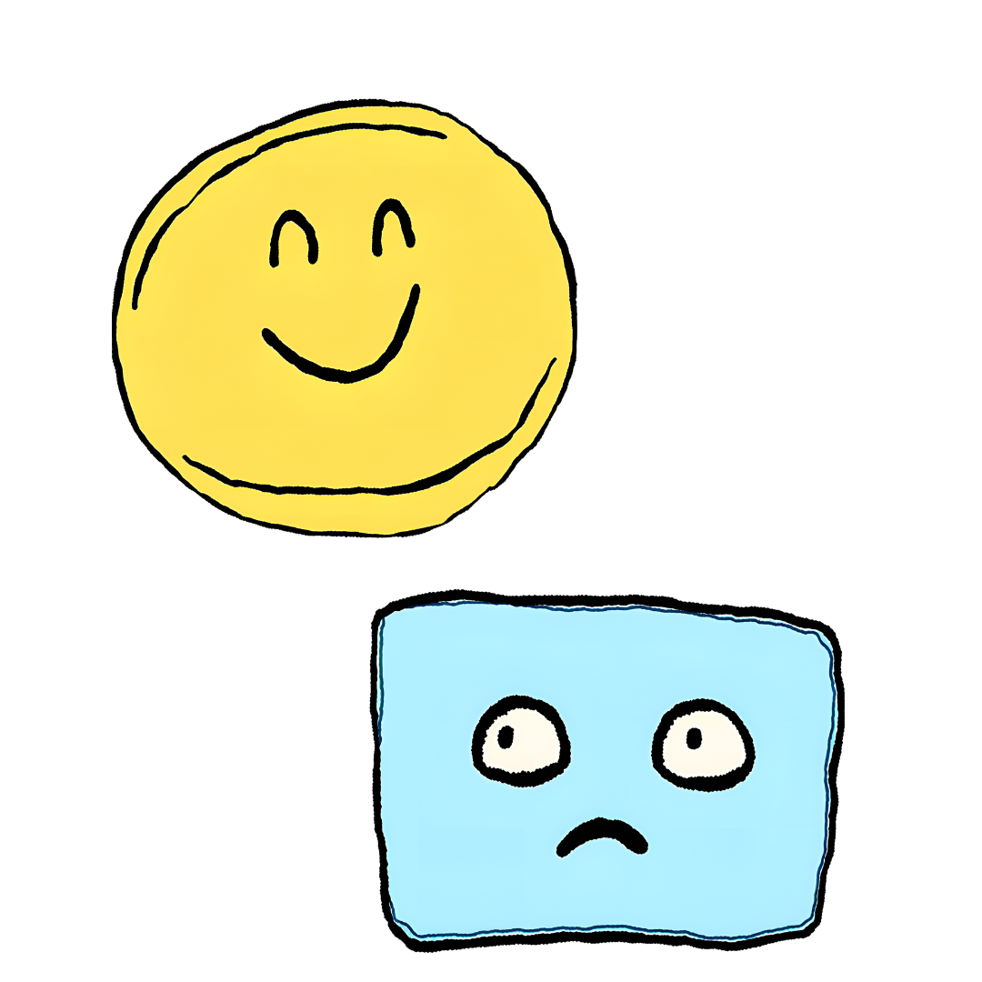
Social impact of AI
The previous example shows how AI applications can end up being biased, and treat different populations differently.
Note that this often happens involuntarily: the algorithm was not trained to be unfair to a group, it has simply learned based on the examples it was shown.
In complex problems, it is difficult to achieve a good representation of the information we are trying to classify, and we are likely dealing with a lot of noise. Coming up with a good algorithm is challenging, and the consequences for real people can be severe.
Notes:
Question for the audience: What kind of bias are we dealing with in this example?
Answer: historical bias

Slide 17
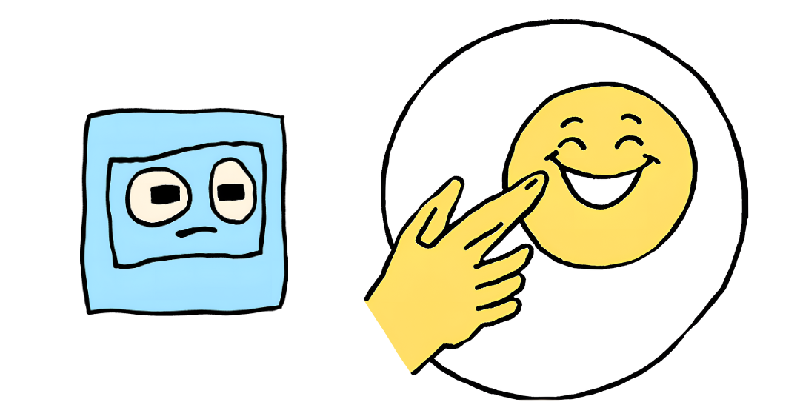
Other kinds of bias - algorithmic bias
A biased dataset will most likely produce a biased algorithm.
We talk about algorithmic bias^{(*)} when an algorithm systematically and unfairly favors a group over others, in a way that has nothing to do with the original intention of the algorithm.
In our example about university admissions, the goal was to admit the best students, but the algorithm is biased against Squares for reasons other than their academic abilities.
^{(*)}Note that, in Machine Learning, we also talk about “high bias” in an algorithm when the algorithm is too simple and inflexible to capture the trend in the data.

Slide 18
Other kinds of bias - evaluation bias
After training, a classification algorithm must be tested on a different set of data, to measure its performance on samples it has not seen before.
If the testing set is biased in a similar way as the training set, we will remain unaware of possible issue with fairness. We may also report incorrect, overly-confident measure of performance, and deploy an algorithm that will end up failing when used in the real world.
To avoid evaluation bias, it is important that the algorithm is tested on a dataset that well represents the population it will be used by (or on).

Slide 19
Why does this matter?
Learning algorithms are becoming increasingly popular and their application widespread, because they are:
Cheap
Scalable
Automated
Unfortunately, they are also:
Seemingly objective - for years, the idea of bias in algorithms was rejected, because it was thought that, because machines do not have emotions, they could not be sexist, racist, etc…
Often lacking appeals processes, because the responsibility of a wrong prediction is difficult to assign (is it the programmer’s fault? Or the client’s?)
Not just predicting but also causing the future – decision algorithms can significantly influence the world on which future algorithms will be based, creating a vicious cycle.

Slide 20
Measuring fairness
As seen before, high accuracy does not guarantee fairness
Other metrics can be used to measure fairness of an algorithm, for example:
statistical parity: whether the rates of positive predictions are on par across groups
equal opportunity: whether the ratios of false negatives to true positives are on par across groups
predictive equality: whether the ratios of false positives to true negatives are on par across groups
-
-
+
-
+
+
-
-
+
-
+
+
-
-
-
+
+
+
+
-
+
+
+
+
Admission test scores
Highest accuracy
Notes:
Unlike accuracy, fairness has many mathematical definitions.
They all try to balance outcomes across protected groups.
You must choose the right one(s) for the application.
There are actually more (you can read this paper by Verma and Rubin for an overview)
In the attached worksheet, students will work from the definition to a formula for each fairness metric (that is why they are not given here)

Slide 21
AI and the environment
We have talked about how AI applications are becoming ubiquitous in society. Few people, however, including few of the developers of these systems, spend time thinking about their environmental impact. Even fewer try to evaluate this impact.
The environmental cost of training and maintaining AI algorithms is not immediately evident, but it includes:
The massive amount of electricity required.
Depending on how that electricity is produced, there is also a variable cost in terms of CO2 released in the atmosphere.
The cost of building and maintaining the hardware on which AI algorithms run.
Recent estimates of AI’s carbon footprint range from 2.1% to 3.9% of the total greenhouse gas emissions. Still a small fraction of what is produced by more polluting industries such as manufacturing (24%) and transportation (27%), but not insignificant.
Source: The Carbon Footprint of Artificial Intelligence

Slide 22
Accuracy-Efficiency Paradox
“There is a recognised trade-off between model accuracy and energy efficiency. In fact, the relationship has been shown to be logarithmic. That is, in order to achieve a linear improvement in accuracy, an exponentially larger model is required. A recent study [...] confirmed the existence of the accuracy-energy trade off [...] and indicated a 30-50% saving in energy for training related to a 1% reduction in accuracy.”
Mill et al., Managing Sustainability Tensions in Artificial Intelligence: Insights from Paradox Theory
Notes:
Reflection question for the audience: is it always worth it to increase the energy demand by 30-50% for a 1% improvement in accuracy?

